Slide 1
Working with SharePoint Content
Using the SPHttpClient to talk to SharePoint
Notes:
In this unit, you'll learn how to use the SharePoint Framework API to retrieve list data from the SharePoint REST API.

Slide 2

Calling REST APIs
Overview Consume REST APIs in SPFx
Understanding the HTTPClient
Calling Anonymous REST APIs
Notes:
In this unit, you'll learn how to call anonymous third-party REST APIs using the SharePoint Framework API.

Slide 3
Overview Consume REST APIs in SPFx
Common requirement in SPFx project is to display or interact with data external to the web part
Data in SharePoint lists & libraries
Data accessible via Microsoft Graph REST API
Data accessible in external 3rd Party APIs – anonymous & secured
SharePoint Framework provides APIs for all situations when you need to work with data sources external to the web part
HttpClient: for calling 3rd party REST APIs
MSGraphClient: for calling the Microsoft Graph in the same tenant as the SharePoint Online tenant
AADHttpClient: for 3rd party REST APIs secured with Azure Active Directory
Most scenarios require no extra clients / libraries are required
Notes:
A common requirement for SharePoint Framework projects is that they display or interact with data external to the web part. This data can reside in SharePoint lists and libraries, or it may be accessible via Microsoft Graph. Maybe the data is external to SharePoint and Microsoft 365 and your project will need to request data from a third party REST API that may support anonymous requests or only support authorized requests because it is protected with Azure AD.
The SharePoint Framework includes multiple APIs you can use that address the different scenarios depending where the data resides and the specifics around the of HTTP API you'll need to call. There are three different APIs you'll use for specific scenarios.
The `HttpClient` API is the cornerstone for most HTTP requests in SharePoint Framework projects. You'll use the `HttpClient` API to primarily submit anonymous requests to third-party APIs. The `SPHttpClient` API extends the `HttpClient` to include necessary HTTP request headers used by the SharePoint REST API. For example, the `SPHttpClient` automatically includes an `odata-version` HTTP request header set to `4` to configure the SharePoint REST API from the default OData v3 protocol to OData v4.
The `MSGraphClient` API is used to call the Microsoft Graph REST API in the same tenant as the current SharePoint Online tenant. Unlike the other HTTP APIs in the SharePointFramework, the `MSGraphClient` API is used to obtain a configured instance of the Microsoft Graph JavaScript SDK client.
The `AADHttpClient` API extends the `HttpClient` API that is used to call Azure AD secured APIs. You'll use the Azure AD HTTP client API to obtain an instance of the `HttpClient` that includes an `authorization` HTTP request header with the value set to an access token used to authorize calls to an Azure AD secured HTTP endpoint.
None of these related HTTP request APIs require developers to install additional clients or libraries; the default SharePoint Framework project includes everything you'll need in your project to submit requests to REST APIs.

Slide 4
Overview Consume REST APIs in SPFx
Common requirement in SPFx project is to display or interact with data external to the web part
Data in SharePoint lists & libraries
Data accessible via Microsoft Graph REST API
Data accessible in external 3rd Party APIs – anonymous & secured
SharePoint Framework provides APIs for all situations when you need to work with data sources external to the web part
HttpClient: for calling 3rd party REST APIs
MSGraphClient: for calling the Microsoft Graph in the same tenant as the SharePoint Online tenant
AADHttpClient: for 3rd party REST APIs secured with Azure Active Directory
Most scenarios require no extra clients / libraries are required
Notes:
A common requirement for SharePoint Framework projects is that they display or interact with data external to the web part. This data can reside in SharePoint lists and libraries, or it may be accessible via Microsoft Graph. Maybe the data is external to SharePoint and Microsoft 365 and your project will need to request data from a third party REST API that may support anonymous requests or only support authorized requests because it is protected with Azure AD.
The SharePoint Framework includes multiple APIs you can use that address the different scenarios depending where the data resides and the specifics around the of HTTP API you'll need to call. There are three different APIs you'll use for specific scenarios.
The `HttpClient` API is the cornerstone for most HTTP requests in SharePoint Framework projects. You'll use the `HttpClient` API to primarily submit anonymous requests to third-party APIs. The `SPHttpClient` API extends the `HttpClient` to include necessary HTTP request headers used by the SharePoint REST API. For example, the `SPHttpClient` automatically includes an `odata-version` HTTP request header set to `4` to configure the SharePoint REST API from the default OData v3 protocol to OData v4.
The `MSGraphClient` API is used to call the Microsoft Graph REST API in the same tenant as the current SharePoint Online tenant. Unlike the other HTTP APIs in the SharePointFramework, the `MSGraphClient` API is used to obtain a configured instance of the Microsoft Graph JavaScript SDK client.
The `AADHttpClient` API extends the `HttpClient` API that is used to call Azure AD secured APIs. You'll use the Azure AD HTTP client API to obtain an instance of the `HttpClient` that includes an `authorization` HTTP request header with the value set to an access token used to authorize calls to an Azure AD secured HTTP endpoint.
None of these related HTTP request APIs require developers to install additional clients or libraries; the default SharePoint Framework project includes everything you'll need in your project to submit requests to REST APIs.

Slide 5
Calling Anonymous REST APIs
import { HttpClient, HttpClientResponse }
from '@microsoft/sp-http’;
return this.context.httpClient.get(
`http://[rest-endpoint]`,
HttpClient.configurations.v1
)
.then((response: HttpClientResponse) => {
return response.json();
})
.then(jsonResponse => {
return jsonResponse;
}) as Promise<any>;
Notes:
To use the `HttpClient` API, first import it into your TypeScript file:
In the code above, we're also importing the `HttpClientResponse` object to cast the object returned from an HTTP request into a typed object.
Next, submit a request using either the `get()` or `post()` method on the `this.context.httpClient` object from a SharePoint Framework component. These two methods have three arguments:
- **endpoint** (*required*): The first argument is the endpoint of the HTTP request you want to call.
- **configuration** (*required*): The second argument is the configuration to use for the request. Always use the `HttpClient.configurations.v1` configuration. This will set the HTTP request headers to the common values such as setting the `accept` header to `application/json` to request the data as JSON.
- **request options** (*optional*): The last argument is optional. It enables developers to pass in a custom request object that overrides any of the configuration settings prior to submitting the request.
The `get()` and `post()` methods return a JavaScript promise with the response as a `HttpClientResponse` object. To parse the body of the response as a JSON object, call the `json()` method that will return a JavaScript promise object containing the response:

Slide 6
CRUD with SharePoint Data in SPFx
CRUD Operations with SPFx & SharePoint REST API
Reading items
Creating items
Updating items
Deleting items
Notes:
In this unit, you'll extend what you learned in a previous unit from just reading SharePoint list data to writing data using the SharePoint REST API. You'll learn how to create, update, and delete data in SharePoint lists and libraries in SharePoint Framework components with the SharePoint REST API.

Slide 7
Accessing the SharePoint REST API
Must include an Authorization header containing an OAuth bearer token
Other headers used to control how the REST API is used
OData v3 or v4 (default = v3)
Amount & type of metadata returned
Type of operation to perform (in the case of updates: merge / update)
Match versions
Notes:
The SharePoint REST API will validate your identity and permissions with each request so you must include authorization details when you submit a request to the SharePoint REST API. Each request is authorized by including an `authorization` HTTP request header that contains an OAuth2 bearer token. This token is provided by Azure AD after a successful authentication and granting the necessary permissions to the app that's accessing the SharePoint REST API. This authorization token is required when you submit a request to the SharePoint REST API from off the SharePoint server.
When you submit a request from a client-side script running on a SharePoint page, the authorization token is not required. That's because each request from the SharePoint site will include a cookie that was added to your browser session when you logged into the SharePoint site. This cookie is used because the SharePoint REST API is available from the SharePoint site which is in the same domain as the page that hosts your client-side script is sent from.
HTTP request headers are used not just for authorization, but to control the OData protocol version the SharePoint REST API uses, how much metadata is returned in each request and many other things. For example, when updating or deleting a request, you can include the `if-match` HTTP request header to verify the item you want to update or delete is the same version on the server that your application expects it to be. This header enables developers to ensure they aren't in a "last update wins" scenario.

Slide 8
OData Query Operators
https://sharepoint/sites/site/ _api/web/lists/getbytitle(‘Countries’)/items?
$select=Id,Title
&$filter=Title eq ‘United States’
&$orderby=ID desc
&$top=1
Notes:
Here is an example of what an OData request looks like:
The SharePoint REST API starts with the **_api** endpoint. The remainder of the path portion of the URL, **web/lists/getbytitle('Countries')/items** in this example, is used to reference a specific resource. In this example, the items in the **Countries** list in the current SharePoint site are returned.
Notice the parameters prefixed with a `$` in the query string of the URL. These are *OData query operators*. OData query operators are used to control how much data is returned in each query.
The `$select` query operator is used to tell the SharePoint REST API to only return specific fields for the items collection. Without the `$select` operator, a default collection of properties are returned.
The `$filter` query operator is used to include only a subset of items from the list.
The `$orderby` query operator allows developers to specify the field to sort the results on and the direction of the sort operation.
Finally, the `$top` query operator is used to only select a subset of the results in the query.
In this example, the last item in the list that has a title of **United States** is returned in the response and it only includes the **ID** and **Title** properties.

Slide 9
SharePoint Framework & REST API
SPFx implements calls to SharePoint REST API via the SPHttpClient
Available from the existing context:
this.context.spHttpClient.get() & this.context.spHttpClient.post()
Based on the existing HttpClient API
Handles the authentication & default config setting:
Authorization HTTP header
OData v4
Minimal metadata returned
Notes:
The SharePoint Framework includes an API that simplifies submitting request to the SharePoint REST API. The `SPHttpClient` API is available in all SharePoint Framework solutions on the `context` object. The `SPHttpClient` extends the to the `HttpClient` API which is a wrapper to the Fetch API included in all modern browsers and includes a polyfill for older browsers that don't support the Fetch API.
The `HttpClient` is also included in the SharePoint Framework API. Developers can use it to submit HTTP requests to any REST API.
The `SPHttpClient` API automatically configures the HTTP request with the required HTTP request headers, including setting the SharePoint REST API OData version to v4 and configuring the response to only include minimal metadata for each item returned.

Slide 10
Reading List Items with the REST API & SPFx
private _getListItems(): Promise<ICountryListItem[]> {
const endpoint: string = this.context.pageContext.web.absoluteUrl
+ `/_api/web/lists/getbytitle('Countries')/items?$select=Id,Title`
return this.context.spHttpClient.get(
endpoint,
SPHttpClient.configurations.v1
)
.then(response => {
return response.json();
})
.then(jsonResponse => {
return jsonResponse.value;
}) as Promise<ICountryListItem[]>;
}
Notes:
To submit a request to the SharePoint REST API, use the `spHttpClient` object on the current component's `context` object. You'll use either the `get()` or `post()` method to submit either an HTTP GET or HTTP POST request.
The first parameter of the request is the SharePoint REST API endpoint you want to request. The second parameter is the configuration to use. The configuration is what sets the HTTP request headers previously mentioned. There is an optional third argument you can pass in that enables developers to override the default configuration settings, for example if you want full metadata or no metadata in the response.
The `get()` and `post()` methods return a JavaScript promise that you can examine the HTTP response headers or the status code of the request. If the response body contains JSON, you can call the `json()` method which also returns a promise containing the parsed body turned as a JSON object.

Slide 11
Write Operations with SPFx & REST API
Use the SharePoint Framework SPHttpClient’s post() method to write to the SharePoint REST API
Some operations require additional HTTP headers:
IF-MATCH: specify version of the item on the server to be updated / deleted
X-HTTP-Method: specify MERGE or DELETE in update & delete operations
Some operation require specific data in the payload body
@odata.type: specify the type of data being written to the list when creating
Notes:
The operations referred to when reading and writing data is simplified to CRUD operations. CRUD stands for **create, read, update, and delete**. A previous unit covered reading data from SharePoint lists. To request data from SharePoint's REST API, you use the `get()` method on the `SPHttpClient` API from the SharePoint Framework API.
When writing data to SharePoint lists and libraries, you most submit HTTP POST requests. This is done using the `post()` method on the `SPHttpClient` API. The `get()` and `post()` methods have the exact same arguments, although each scenario may require additional steps.
For example, when updating or deleting an item in a SharePoint list, you should include the `IF-MATCH` HTTP request header. You should also include the `X-HTTP-METHOD` when updating and deleting SharePoint list items as well. These two request headers are covered in more detail in the sections on updating and deleting items later in this unit.
When creating or updating a SharePoint list item, you must submit the data for the new or updated item. This is done by including a JSON object that represents the new or updated item as a string in the body of the request. This object should also indicate what type of data it is using the `@odata.type` property. This is covered in more detail in the sections on creating and updating list items later in this unit.

Slide 12
Creating List Items with the REST API
Must specify the type of data as the @odata.type property in the payload that is being created
Due to lists being able to support multiple content types
Pattern: request the type in a pre-request via the list’s ListItemEntityTypeFullName property
Notes:
You must tell the SharePoint REST API the data type of the item submitted in the request payload when you create a new list item. To do this, specify the data type in the `@odata.type` property in the payload of the request.
This is required as SharePoint lists can support multiple content types. Each content type can have unique or shared fields, but each field can have different settings, such as if they're required or not. Therefore, when creating an item, you must tell SharePoint the type of data so SharePoint knows which content type rules to enforce.
You can obtain a list of all the data types supported on a list using the lists `ListItemEntityTypeFullName` property. It will return the data type supported by the list.

Slide 13
Get List Entity Type
private _getItemEntityType(): Promise<string> {
const endpoint: string = this.context.pageContext.web.absoluteUrl
+ `/_api/web/lists/getbytitle('Countries')?$select=ListItemEntityTypeFullName`
return this.context.spHttpClient.get(
endpoint,
SPHttpClient.configurations.v1
)
.then(response => {
return response.json();
})
.then(jsonResponse => {
return jsonResponse.ListItemEntityTypeFullName;
}) as Promise<string>;
}
Notes:
Let's look at an example. This TypeScript method requests the data type for the **Countries** list. It does this by requesting the `ListItemEntityTypeFullName` property on the list and returning it back as a string in a JavaScript promise:

Slide 14
Creating List Items with the REST API & SPFx
private _addListItem(): Promise<SPHttpClientResponse> {
return this._getItemEntityType()
.then(spEntityType => {
const request: any = {};
request.body = JSON.stringify({
Title: new Date().toUTCString(),
'@odata.type': spEntityType
});
const endpoint: string = this.context.pageContext.web.absoluteUrl + `/_api/web/lists/getbytitle('Countries')/items`;
return this.context.spHttpClient.post(
endpoint, SPHttpClient.configurations.v1, request);
});
}
Notes:
Call this method prior to creating a new list item. The following TypeScript method calls the `_getItemEntityType()` method to first get the data type supported by the list. It then creates a JSON object for the new item, setting the `Title` property of the item and the `@odata.type` property:
Once the item is created, the object is converted to a JSON string using the `JSON.stringify()` method which is set to the `body` property of the request. Notice in the `SPHttpClient.post()` method, the third argument passed into the method is the request.

Slide 15
Updating List Items with the REST API
Should specify the type of operation to perform
Default behavior is to set properties to supplied values, BUT omitted properties are set to null
Override behavior using the MERGE method
Set using the X-HTTP-Method header
Specify the version of the item to update
When updating items, can specify “only update the item on the server if it is version X”
Ensures you aren’t overwriting someone else’s changes unknowingly
Enforced with the IF-MATCH header & etag’s
Notes:
Updating list items with the SharePoint REST API is very similar to creating items with a few small differences.
To update an item, you can submit an HTTP PUT or HTTP MERGE operation to the SharePoint REST API. The difference between the two is that PUT will update all properties on the specified item while MERGE will only update those properties included in the body of the request. This means that any properties omitted when submitting an HTTP PUT will be nulled out because no value was submitted.
If this is not the behavior you want, you can use the HTTP MERGE method which will ignore any properties not included in the body of the payload.
The challenge with the HTTP MERGE method is that not all networking equipment and libraries support it. To get around this limitation, specify the desired method in an HTTP POST with the HTTP request header `X-HTTP-METHOD`. Set the `X-HTTP-METHOD` to `MERGE` when you submit an HTTP POST using the `SPHttpClient.post()` method when you want the SharePoint REST API to treat the HTTP POST as an HTTP MERGE.
When you update an item, you need to be sure that you are updating same version of the item that is on the server. In other words, you don't want to update an item that has changed since you previously retrieved it, otherwise you would overwrite another user's changes.
To protect against this scenario, use the `IF-MATCH` HTTP request header and set it's value to the **etag** of the current item. The etag is a unique string for the specific version of the item. If the etag matches the etag of the item on the server, the update is applied. If the etags don't match, the SharePoint REST API will return an HTTP error code 419 indicating the expected etag didn't match.

Slide 16
Updating List Items with REST API & SPFx
private _updateListItem(): Promise<SPHttpClientResponse> {
// get the first item
return this.context.spHttpClient.get(
// .. code to get item from SP REST API
})
.then((listItem: ICountryListItem) => {
// update item
listItem.Title = 'USA';
// save it
const request: any = {};
request.headers = {
'X-HTTP-Method': 'MERGE',
'IF-MATCH': (listItem as any)['@odata.etag']
};
request.body = JSON.stringify(listItem);
const endpoint: string = this.context.pageContext.web.absoluteUrl + `/_api/web/lists/getbytitle('Countries')/items(${listItem.Id})`
return this.context.spHttpClient.post(endpoint, SPHttpClient.configurations.v1, request);
});
}
Notes:
The following TypeScript method demonstrates updating an item in a SharePoint list. After first obtaining an item from a list, it then modifies the returned object's `Title` property. Next, the two HTTP request headers `IF-MATCH` and `X-HTTP-METHOD` are added as previously discussed.
Finally, the `request` object's `body` property is set with the JSON string version of the object. Notice that unlike creating an item, the endpoint of the request includes the unique endpoint of the item to be updated:

Slide 17
Deleting List Items with the REST API
Should specify the type of operation to perform
Underlying fetch API only contains post() method; not delete()
Override behavior using the DELETE method
Set using the X-HTTP-Method header
Specify the version of the item to delete
When updating items, can specify “only update the item on the server if it is version X”
Enforced with the IF-MATCH header & etag’s
Decide: does it matter if the version is different?
If not, use IF-MATCH = ‘*’
Notes:
Deleting list items with the SharePoint REST API is very similar to updating items with a few small differences.
The `SPHttpClient` API does not include a `delete()` method like the `get()` and `post()` methods. Instead, to submit an HTTP DELETE request, you'll use the `X-HTTP-METHOD` HTTP request header and set it to `DELETE`. Similar to how you update an item, this will tell the SharePoint REST API to treat the HTTP POST as an HTTP DELETE request.

Slide 18
Deleting List Items with REST API & SPFx
private _deleteListItem(): Promise<SPHttpClientResponse> {
// get the first item
return this.context.spHttpClient.get(
// .. code to get item from SP REST API
})
.then((listItem: ICountryListItem) => {
// delete it
const request: any = {};
request.headers = {
'X-HTTP-Method': 'DELETE',
'IF-MATCH': '*'
};
const endpoint: string = this.context.pageContext.web.absoluteUrl + `/_api/web/lists/getbytitle('Countries')/items(${listItem.Id})`
return this.context.spHttpClient.post(endpoint, SPHttpClient.configurations.v1, request);
});
}
Notes:
The following TypeScript method demonstrates how to delete an item in a SharePoint list. After first obtaining an item from a list, it then modifies the request using the HTTP request headers `IF-MATCH` and `X-HTTP-METHOD` are added as previously discussed.

Slide 19
Demo CRUD with SharePoint Data

Slide 20
Calling Azure AD Protected 3rd Party REST APIs
Azure AD Protected Resources & SPFx: How it Works
Permission Requests
SPFx’s AadHttpClient
Notes:
In this unit, you'll learn how to use the SharePoint Framework API to call REST APIs that are secured with Azure AD.

Slide 21
Securing REST APIs with Azure AD
Resources in Azure can be easily secured with Azure AD
Requires a request to include a valid OAuth access token in the HTTP header on request
Similar to how existing services are secured
SharePoint REST API
Microsoft Graph API
Azure Management REST API
etc.
Notes:
Resources in Microsoft Azure can be secured with Azure AD. Azure AD can be used to secure REST APIs that are hosted in Microsoft Azure and API hosted in other cloud platforms. Microsoft Azure hosted resources are usually easier to secure as the Azure Management Portal provides a simplified configuration experience.
Azure AD secured REST APIs require all requests to be authorized. To authorize a request, you'll include an OAuth 2.0 access token in the `authorization` HTTP request header. This access token must be obtained from Azure AD using one of the supported OAuth flows.
All available Microsoft REST APIs that don't support anonymous requests are secured with Azure AD. This includes APIs including the SharePoint REST API, Microsoft Graph, Azure Management REST API and many more.

Slide 22
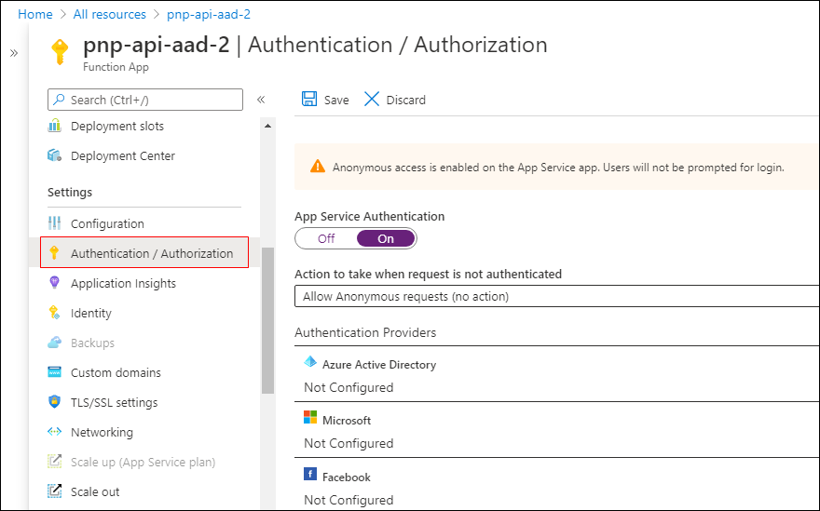
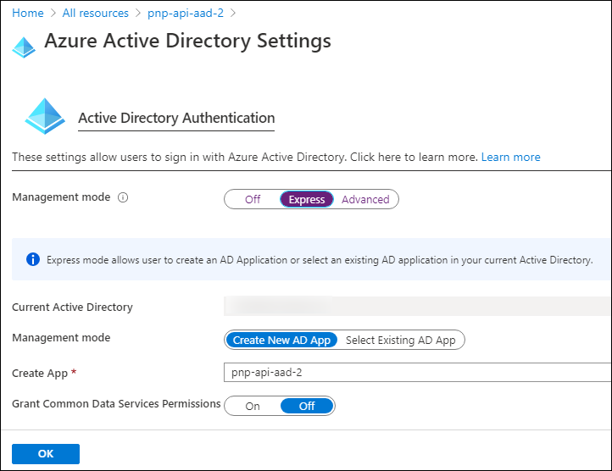
Securing Azure Functions
Notes:
A common approach to implementing a REST API is to use Azure Functions. Securing an Azure Function with Azure AD is simple. In the left-hand navigation, select the **Authentication / Authorization** menu item. The **Authentication / Authorization** blade supports authentication using different OAuth 2.0 providers, including Azure AD, Microsoft Accounts, Facebook, and Google.
After enabling authentication and selecting **Azure AD**, you will then either create a new Azure AD app or associate the Azure Function app with an existing Azure AD app.
By enabling Azure AD authentication and authentication on an Azure Function, Microsoft Azure will automatically check for a valid access token in the `authorization` HTTP request header in every request received. If the access token isn't present or not valid, the request is rejected. This verification check is done without you having to write any special code in your Azure Function.

Slide 23
Calling Azure AD Secured Resources from SPFx
Permission requests to resources are granted to special SharePoint app by tenant admin
SharePoint Online Client Extensibility Web Application Principal
Present in each SharePoint Online tenant
Permissions are unique to the tenant, not the SPFx solution
Once a permission is granted, all solutions can leverage the grant
Permission grant is valid until revoked
Permission grant not directly linked to the solution that requested it
Solution installation not linked to permission grant approval / rejection
Notes:
Let's look at how requests to Azure AD secured resources are handled by the SharePoint Framework.
Permission requests to REST APIs, also known as *resources*, are granted to a Azure AD app provisioned in every SharePoint Online tenant: **SharePoint Online Client Extensibility Web Application Principal**.
When you grant a permission request for a specific resource, such as Microsoft Graph, to the **SharePoint Online Client Extensibility Web Application Principal** app, you are granting that entire SharePoint Online tenant the permission. Its important to understand that this permission grant isn't unique to the site or to the SharePoint Framework component; the permission grant applies to the *entire SharePoint Online tenant*.

Slide 24
Granting Permissions to SharePoint Online
Special SharePoint Online Azure AD app can be granted permissions to resources in multiple ways:
Defined within solution manifest – admin notified upon deployment to approve/reject
PowerShell
Office 365 CLI
Ref: https://docs.microsoft.com/sharepoint/dev/spfx/use-aadhttpclient
Notes:
There are three ways you can request and grant permissions to a SharePoint Online tenant:
- **Defined with the SharePoint Framework package solution manifest**: In this option, you'll define the permission requests for the resources that your solution needs in order to run. When the solution is deployed to the App Catalog site, the administrator is notified that they will need to approve or reject the permission request.
- **PowerShell**: PowerShell can be used to submit a permission request, and approve or reject permission requests. You can also use PowerShell to create the permission grant, bypassing the request process.
- **Office 365 CLI**: You can also use the cross-platform Office 365 CLI to request, approve, reject, grant and revoke permission requests the same way you can with PowerShell.

Slide 25
SPFx Solutions Declare Permission Requests
// package-solution.json
{
"$schema": "https://developer.microsoft.com/json-schemas/spfx-build/package-solution.schema.json",
"solution": {
"name": "sp-fx-aad-http-client-side-solution",
"id": "dfb230b7-4f61-431f-9b65-a34e83922663",
"version": "1.0.0.0",
"includeClientSideAssets": true,
"isDomainIsolated": false,
"webApiPermissionRequests": [
{ "resource": "Microsoft Graph", "scope": "User.ReadBasic.All” }
]
},
"paths": {
"zippedPackage": "solution/sp-fx-aad-http.sppkg"
}
}
Notes:
To request a permission when a SharePoint Framework package is deployed to the App Catalog, add it to the `webApiPermissionRequests` array in the **package-solution.json** configuration file in a project.
Each request must include the name of the REST API (`resource`) and the permission (`scope`) requested:

Slide 26
How It Works: Calling Azure AD Secured REST APIs from SPFx
Notes:
After SharePoint Framework package has been added to the App Catalog, let's look the process for granting permissions and how the SharePoint Framework ultimately submits requests to the Azure AD secured REST API.
At the bottom of the figure above, the tenant administrator grants the permissions (also known as *scopes*), to the SharePoint Online tenant. This is done from the API Management page in the SharePoint Admin Center.
Once the permission request is granted, the SharePoint Framework component will ask SharePoint Online for an access token for the specified resource. The SharePoint Online, in conjunction with Azure AD, will validate the permission for the specified resource has been granted to that SharePoint Online tenant and return an access token. The SharePoint Framework will then submit a request to the REST API and include the access token in the `authorization` HTTP request header.
The Azure AD secured resource will verify the `authorization` HTTP request header before passing to the REST API. From this point, the HTTP request continues like normal, processing the request and sending the response back to the SharePoint Framework component.

Slide 27
Using the Azure AD HTTP Client
import { AadHttpClient, HttpClientResponse } from '@microsoft/sp-http';
this.context.aadHttpClientFactory
.getClient(“https://your-endpoint-uri”)
.then((aadClient: AadHttpClient) => {
const endpoint: string = “https://your-endpoint-uri/api”;
aadClient.get(endpoint, AadHttpClient.configurations.v1)
.then((rawResponse: HttpClientResponse) => {
return rawResponse.json();
})
.then((jsonResponse: any) => {
// work with result
});
});
Notes:
The SharePoint Framework API simplifies the access token acquisition from SharePoint Online and Azure AD. The API uses the token to configure a special instance of the `HttpClient`, known as the `AadHttpClient`, you'll use to submit the request.
To do this, start by importing the `AadHttpClient` object into your TypeScript file:
Next, use the `aadhttpClientFactory` to request an HTTP client configured with the access token for the specified resource:
Finally, use the configured client to call the secured REST API the same way you can use the `HttpClient`:

Slide 28
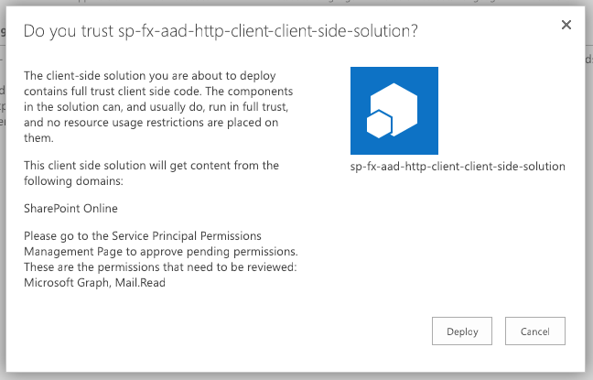
Add SharePoint Package to SharePoint App Catalog
Upload SharePoint packages to the app catalog
Extra note in dialog notifies of additional step required
While application can be installed in SharePoint sites, it does not have the permissions granted that it needs to access Azure AD protected resources
Notes:
When an administrator deploys the SharePoint Framework component to the tenant App Catalog, they're presented with an additional message in the trust dialog prompt:
This message instructs the administrator this solution contains permission requests that should be reviewed and approved or rejected. Recall that permissions are not tied to the SharePoint Framework package. Approving or rejecting the permissions is a separate step that must be performed in order for the SharePoint Framework component to work.

Slide 29
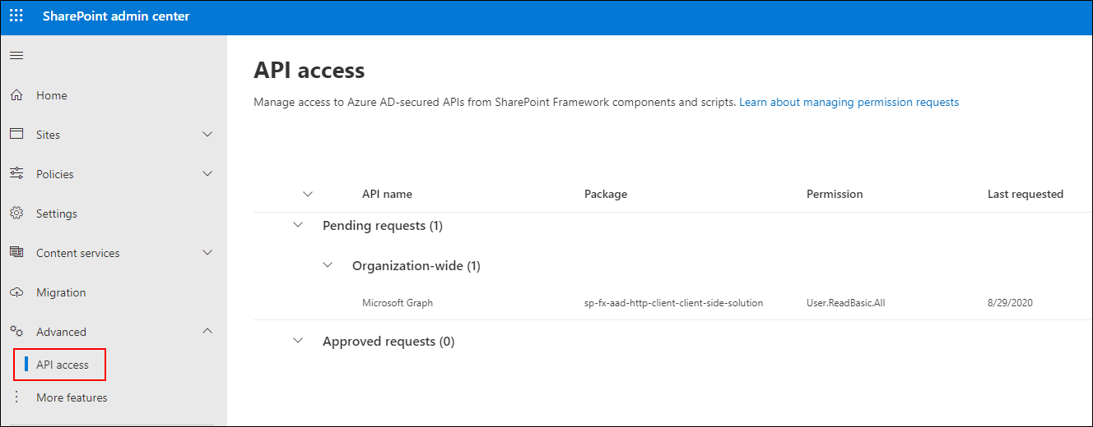
Approve / Reject with SharePoint Online API Management Page
Notes:
To approve or reject permission requests, navigate to the **API access** page in the **SharePoint Admin Center**. Here you'll find a list of permission requests pending approval or rejection.

Slide 30
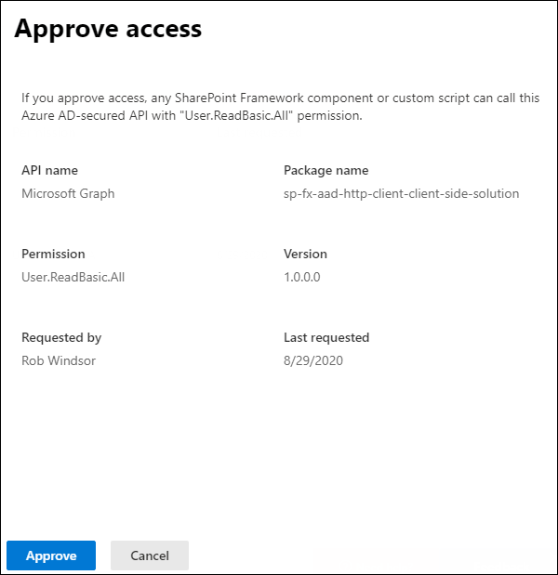
Approve / Reject with SharePoint Online API Management Page
Notes:
Select the permission request to view its details and use the buttons at the bottom of the panel to approve or reject the request:

Slide 31
Calling the Microsoft Graph
Overview of the Microsoft Graph
Microsoft Graph JavaScript API
TypeScript Type Declarations
SPFx’s MSGraphClient
Notes:
In this unit, you'll learn how to incorporate Microsoft Graph into your custom SharePoint Framework solutions.

Slide 32

Microsoft 365 Platform
Extend Microsoft 365 experiences
web, device, and service apps
Build your experience
Documents
Pages
Conversations
Timeline
iOS/Android/Windows/Web
1
Microsoft Graph
Notes:
The Microsoft 365 developer vision focuses on the user's experience and their data and as a developer you can bring your application into the user experience with over 1.2 billion users of Office worldwide. This is a huge opportunity to provide a window into your application and to enable users to connect into their data to intelligence to your application.
There are currently over 850 million events created each month and a total of over 400 petabytes of data stored in the service that can add value for your users.
The Microsoft Graph is the gateway to your data in the Microsoft cloud as you see there.

Slide 33

Microsoft Graph Gateway to your data in the Microsoft-cloud
https://graph.microsoft.com
Office 365
Windows 10
Enterprise Mobility + Security
Users, Groups, Organizations
Outlook
SharePoint
OneDrive
Teams
Planner
Excel
OneNote
Activities
Device Relay
Commands
Notifications
Azure AD
Intune
Identity Manager
Advanced Threat Analytics
Advanced Threat Protection
Mail, Calendar,
Contacts and Tasks
Sites and Lists
Drives and Files
Channels, Messages
Tasks and Plans
Spreadsheets
Notes, and more…
Identity Management
Access Control
Synchronization
Domains
Administrative Units
Applications and Devices
Advanced Threat Analytics
Advanced Threat Protection
Alerts
Policies
and more…
Notes:
The Microsoft cloud is included of multiple services and data types that we can take advantage of from Office 365, and it's all considered part of the Microsoft 365 platform.
Developers can integrate the signed-in user's email, calendar, contacts, and tasks into custom apps. We can work with content in SharePoint sites and lists files in OneDrive, channels and content within Microsoft Teams, and users in Azure Active Directory (Azure AD).
There are many different services that developers can take advantage of in their custom apps. Many of these services have their own APIs developers can interact with.
However, this can be challenging to go to each of these individual services with their individual endpoints. Each API may have its own permission model, which means they have individual access control configurations. Different endpoints for each service mean our custom applications will need to obtain an access token from Azure AD for each one.

Slide 34
Microsoft Graph, gateway to Office 365
Single resource that proxies multiple Microsoft services
Allows for easy traversal of objects and relationships
Simplifies token acquisition and management
Eliminates the need to traditional discovery (using “me” and “myorganization”)
Notes:
One of the benefits of Microsoft Graph is that it serves as a proxy endpoint to all of these other services. Microsoft Graph encompass things such as Office 365, Windows 10 enterprise mobility and security (EMS), and it brings all of these different services under one unified endpoint: **graph.microsoft.com**.
The advantage to using Microsoft Graph is that it allows developers to just have a single endpoint, a resource, which means you're only going to need a single access token authenticate the different services. Each service still has its own individual permissions so that everything is still secured in an individual way. A single endpoint makes it easier for developers to build applications.
Microsoft Graph also enables easy navigation of entities and the relationships between entities. While there are many different Microsoft 365 services such as OneDrive for files, or Outlook for contacts and calendars, these different entities are related to each other. These relationships are in Microsoft Graph, which makes it easy to navigate from one entity to another, even if it crosses different underlying endpoints.

Slide 35
Microsoft Graph JavaScript SDK
Microsoft Graph is accessible via REST API & various SDKs
Client-side solutions can leverage the JavaScript SDK
https://github.com/microsoftgraph/msgraph-sdk-javascript
Requires initialization with an Azure AD provided OAuth2 access token to create the client
Notes:
Microsoft Graph is accessible as a REST API so developers can use any technology that supports submitting and processing an HTTP request to an endpoint. Microsoft also offers many different SDKs for Microsoft Graph for different platforms and technologies to improve developer productivity.
One of the options offered by Microsoft is the [Microsoft Graph JavaScript SDK](https://github.com/microsoftgraph/msgraph-sdk-javascript). After initializing the SDK with an OAuth 2.0 access token, you can use the SDK to submit requests to Microsoft Graph. The SDK communicates directly with the Microsoft Graph REST API and returns the results as well known objects. Microsoft also provides TypeScript type declarations for the SDK for TypeScript-based projects.

Slide 36
Initializing the Microsoft Graph JS SDK
var client = MicrosoftGraph.Client.init({
authProvider: (done) => {
done(null, access_token);
}
});
client
.api('me')
.get((err, res) => {
console.log(res);
});
Notes:
To use the JavaScript SDK, you must first initialize it. This is done by setting the OAuth 2.0 access token before you submit any requests to Microsoft Graph.
Initialize the Microsoft Graph JavaScript SDK by calling the `init()` method and pass in an object with an `authProvider` implementation. The `authProvider` function contains one argument, a callback, that you call with two arguments. The second argument should be the access token.
Once the Microsoft Graph client is initialized, you can submit requests to Microsoft Graph endpoints using the `api()` method. The JavaScript SDK is a fluent API, which means you can chain multiple methods together. For instance, to get the current user's information, you can call the `get()` method after calling the `api()` method.

Slide 37
Microsoft Graph TypeScript Type Declarations
Use the Microsoft Graph JavaScript SDK in TypeScript applications
TypeScript type declarations introduce strong types and documentation to client-side projects
https://github.com/microsoftgraph/msgraph-typescript-typings
Notes:
While the Microsoft Graph JavaScript SDK is written in JavaScript, just like other libraries, you can use it in TypeScript applications including SharePoint Framework projects. Once the [Microsoft Graph TypeScript Type Definitions](https://github.com/microsoftgraph/msgraph-typescript-typings) are installed in TypeScript-based projects, you can then import relevant objects into your TypeScript files.

Slide 38
Microsoft Graph TypeScript Type Declarations
import * as MicrosoftGraph from '@microsoft/microsoft-graph-types';
// init Microsoft Graph client
client
.api('/me')
.get((error: any, user: MicrosoftGraph.User, rawResponse?: any) => {
console.log('name: ', user.displayName);
console.log('email: ', user.mail);
console.log('phone: ', user.businessPhones[0]);
});
});
Notes:
Install the Microsoft Graph TypeScript type declarations by executing the following statement on the command line:
```shell
npm install @microsoft/microsoft-graph-types --save-dev
```
Once installed, you can then use the types in your projects:

Slide 39
SharePoint Framework Includes a Microsoft Graph Client
MSGraphClient: SharePoint Framework’s Microsoft Graph Client
Abstracts the token acquisition from the SharePoint Framework’s support for Azure AD
Wraps the Microsoft Graph JavaScript SDK and initializes it with one line that returns a promise
this.context.msGraphClientFactory
.getClient()
.then((client: MSGraphClient): void => {
// use MSGraphClient here
});
Notes:
You can use Microsoft Graph in your custom SharePoint Framework solutions. Microsoft Graph is a service that is secured with Azure AD. The SharePoint Framework leverages the same infrastructure for requesting and granting permissions to Azure AD secured APIs as it does for custom Azure AD secured APIs. The unit on **Call Azure AD secured third-party REST APIs** explains how the SharePoint Framework API can be used to call Azure AD secured endpoints.
The SharePoint Framework API includes the Microsoft Graph JavaScript SDK and also handles the initialization of the client. This is handled using the existing Azure Ad support to obtain an access token.
To obtain an instance of the Microsoft Graph JavaScript SDK, use the `this.context.msGraphClientFactory.getClient()` method. This will return an instance of the `MSGraphClient` that is already configured with the necessary OAuth 2.0 access token:

Slide 40
SPFx Solutions Declare Permission Requests
// package-solution.json
{
"$schema": "https://developer.microsoft.com/json-schemas/spfx-build/package-solution.schema.json",
"solution": {
"name": "ms-graph-sp-fx-client-side-solution",
"id": "dfb230b7-4f61-431f-9b65-a34e83922663",
"version": "1.0.0.0",
"includeClientSideAssets": true,
"isDomainIsolated": false,
"webApiPermissionRequests": [
{ "resource": "Microsoft Graph", "scope": "User.ReadBasic.All” },
{ "resource": "Microsoft Graph", "scope": "Calendars.Read” },
{ "resource": "Microsoft Graph", "scope": "Tasks.Read” }
]
},
"paths": {
"zippedPackage": "solution/ms-graph-sp-fx.sppkg"
}
}
Notes:
Because Microsoft Graph is an Azure AD secured API, you will need to request a permission to Microsoft Graph when a SharePoint Framework package is deployed to the App Catalog. Do this using the `webApiPermissionRequests` array in the **package-solution.json** configuration file in a project.
Each request must include the name of the REST API (`resource`) and the permission (`scope`) requested:

Slide 41
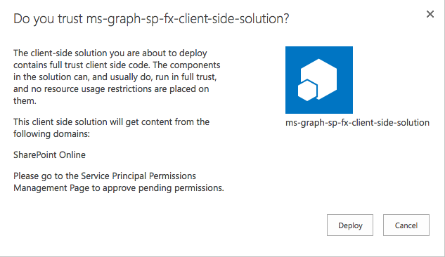
Add SharePoint Package to SharePoint App Catalog
Upload SharePoint packages to the app catalog
Extra note in dialog notifies of additional step required
While application can be installed in SharePoint sites, it does not have the permissions granted that it needs to access Azure AD protected resources
Notes:
When an administrator deploys the SharePoint Framework component to the tenant App Catalog, they're presented with an additional message in the trust dialog prompt:
This message instructs the administrator this solution contains permission requests that should be reviewed and approved or rejected. Recall that permissions aren't tied to the SharePoint Framework package. Approving or rejecting the permissions is a separate step that must be done in order for the SharePoint Framework component to work.

Slide 42
Approve / Reject with SharePoint Online API Management Page
Notes:
To approve or reject permission requests, navigate to the **API access** page in the **SharePoint Admin Center**. Here you'll find a list of permission requests pending approval or rejection.

Slide 43
Approve / Reject with SharePoint Online API Management Page
Notes:
Select the permission request to view its details and use the buttons at the bottom of the panel to approve or reject the request:

Slide 44
Demo Calling the Microsoft Graph

Slide 45
PNP Js library for data interaction
Overview of the PnPJs
Getting started
Notes:
In this unit, you'll learn how to incorporate Microsoft Graph into your custom SharePoint Framework solutions.

Slide 46
Getting Started with PnPJs
PnPjs is a collection of fluent libraries for consuming SharePoint, Graph, and Office 365 REST APIs in a type-safe way.
https://pnp.github.io/pnpjs/
Ideal for SPFx
Great documentation
Easy to set up and use
npm install @pnp/sp @pnp/graph –save
Notes:
When an administrator deploys the SharePoint Framework component to the tenant App Catalog, they're presented with an additional message in the trust dialog prompt:
This message instructs the administrator this solution contains permission requests that should be reviewed and approved or rejected. Recall that permissions aren't tied to the SharePoint Framework package. Approving or rejecting the permissions is a separate step that must be done in order for the SharePoint Framework component to work.

Slide 47
Getting Started with PnPJs
Initialize by passing the context
import { sp } from "@pnp/sp";
import { graph } from "@pnp/graph";
//...
public onInit(): Promise<void> {
return super.onInit().then(_ => {
// other init code may be present
sp.setup({
spfxContext: this.context
});
graph.setup({
spfxContext: this.context
}); sp.setup({
spfxContext: this.context
});
});
}
Notes:
When an administrator deploys the SharePoint Framework component to the tenant App Catalog, they're presented with an additional message in the trust dialog prompt:
This message instructs the administrator this solution contains permission requests that should be reviewed and approved or rejected. Recall that permissions aren't tied to the SharePoint Framework package. Approving or rejecting the permissions is a separate step that must be done in order for the SharePoint Framework component to work.

Slide 48
Getting Started with PnPJs
Import additional components vs All
Keep the bundle smaller
SharePoint
import { sp } from "@pnp/sp";
import "@pnp/sp/webs";
import "@pnp/sp/lists";
import "@pnp/sp/items";
// get all the items from a list
const items: any[] = await sp.web.lists.getByTitle("My List").items.get();
MS Graph
import { graph } from "@pnp/graph";
import "@pnp/graph/users";
const currentUser = await graph.me();
Notes:
When an administrator deploys the SharePoint Framework component to the tenant App Catalog, they're presented with an additional message in the trust dialog prompt:
This message instructs the administrator this solution contains permission requests that should be reviewed and approved or rejected. Recall that permissions aren't tied to the SharePoint Framework package. Approving or rejecting the permissions is a separate step that must be done in order for the SharePoint Framework component to work.

Slide 49
Demo PnPJs

